Slide 1
Kubernetes
Notes:
1

Slide 2











HOW IT WORKS ?

Slide 3
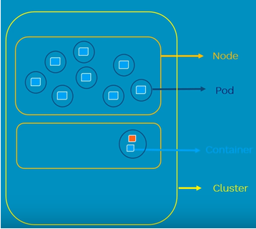
POD
Atomic unit of scheduling
Can have one or more container

Slide 4
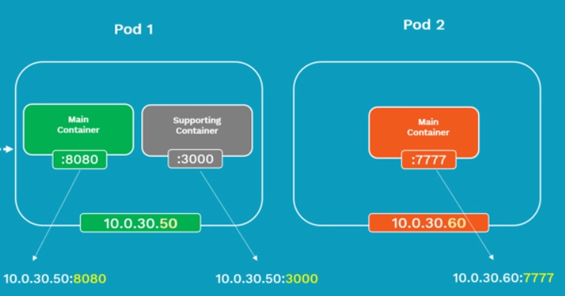
POD
Each POD will have a Pod IP address
Containers inside a POD share same network namespace
Containers inside a POD can communicate using localhost

Slide 5
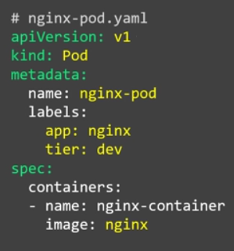
POD
kubectl create –f nginx-pod.yaml
kubectl get pods -o wide

Slide 6
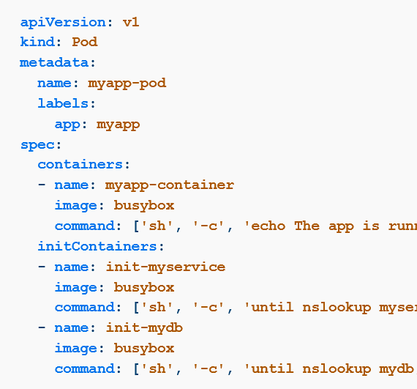
Init Containers
Init container is the one that starts and executes before other containers in the same Pod.
Meant to perform initialization logic for the main application hosted on the Pod.

Slide 7
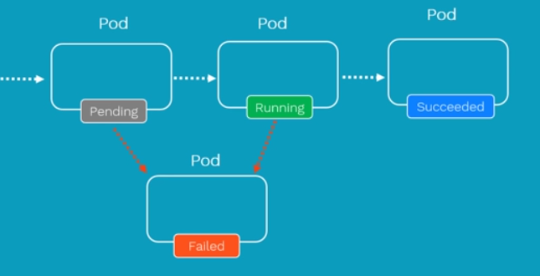
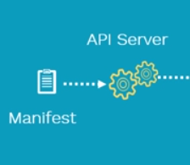


POD Lifecyle

Slide 8
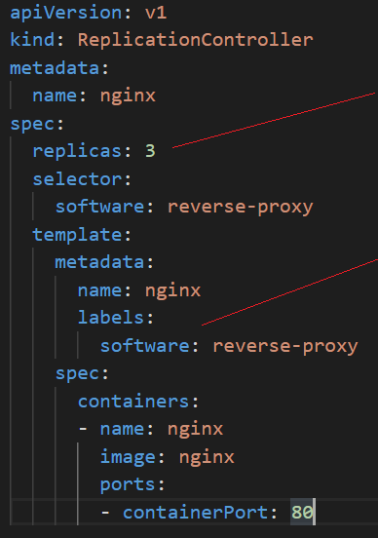
Replication Controller
Ensure that specified number of PODs are running at any point in time
If PODs fail, new ones are created to match the number
ReplicationController and POD is associated using labels

Slide 9
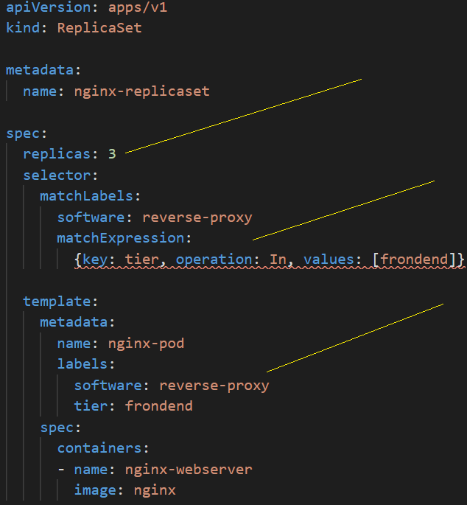
ReplicaSet
Ensure that specified number of PODs are running at any point in time
If PODs fail, new ones are created to match the number
ReplicationController and POD is associated using labels. Match is performed using set based operator

Slide 10
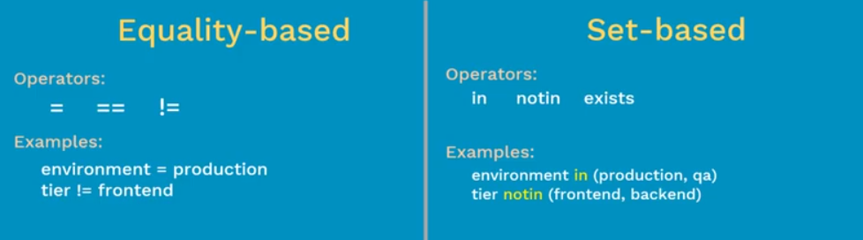
Replication Controller v/s and ReplicaSet
ReplicationController
ReplicaSet

Slide 11
Deployment
Bring your application into desired state
Rollback deployment
Update pods
Pauses/Resume a deployment
Scale deployment

Slide 12
Deployment Strategies
Define how to replace old pods by new ones
spec.strategy.type
Rolling update

Slide 13
Deployment Strategies
Supported Strategy types
recreate: terminate the old version and release the new one
ramped: release a new version on a rolling update fashion, one after the other
blue/green: release a new version alongside the old version then switch traffic
canary: release a new version to a subset of users, then proceed to a full rollout
a/b testing: release a new version to a subset of users in a precise way

Slide 14
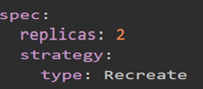
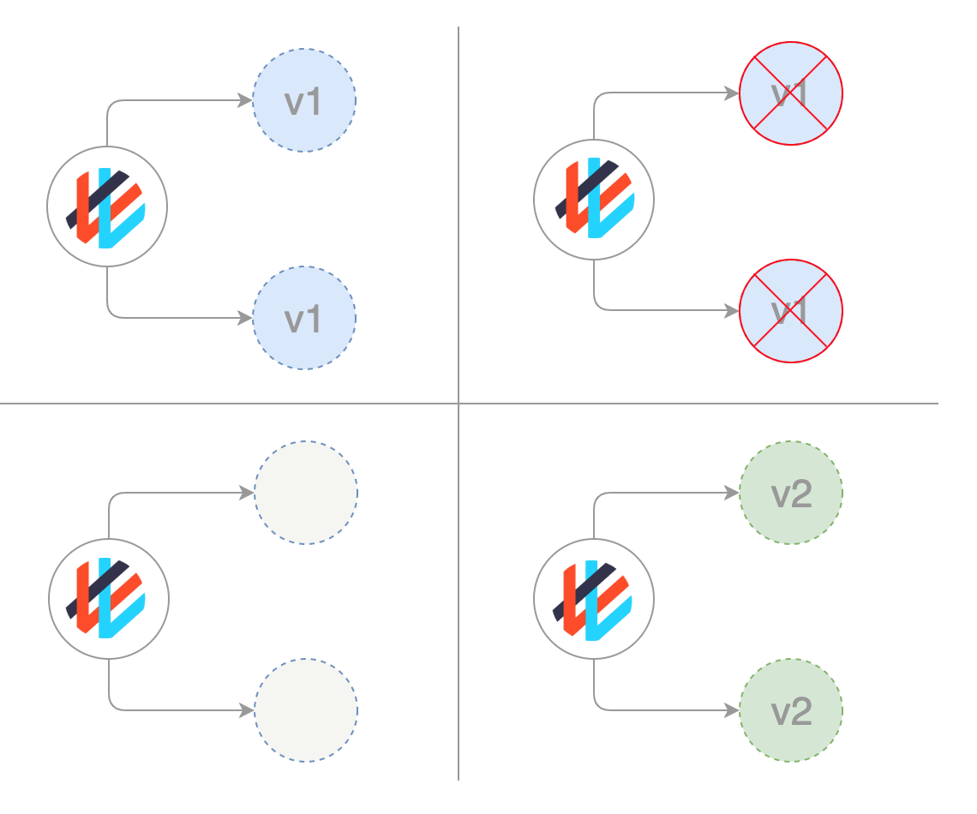
Deployment Strategies - Recreate
Terminate all the running instances then recreate them with the newer version
For Exp: - Development Environment
Downtime that depends on both shutdown and boot duration of the application

Slide 15
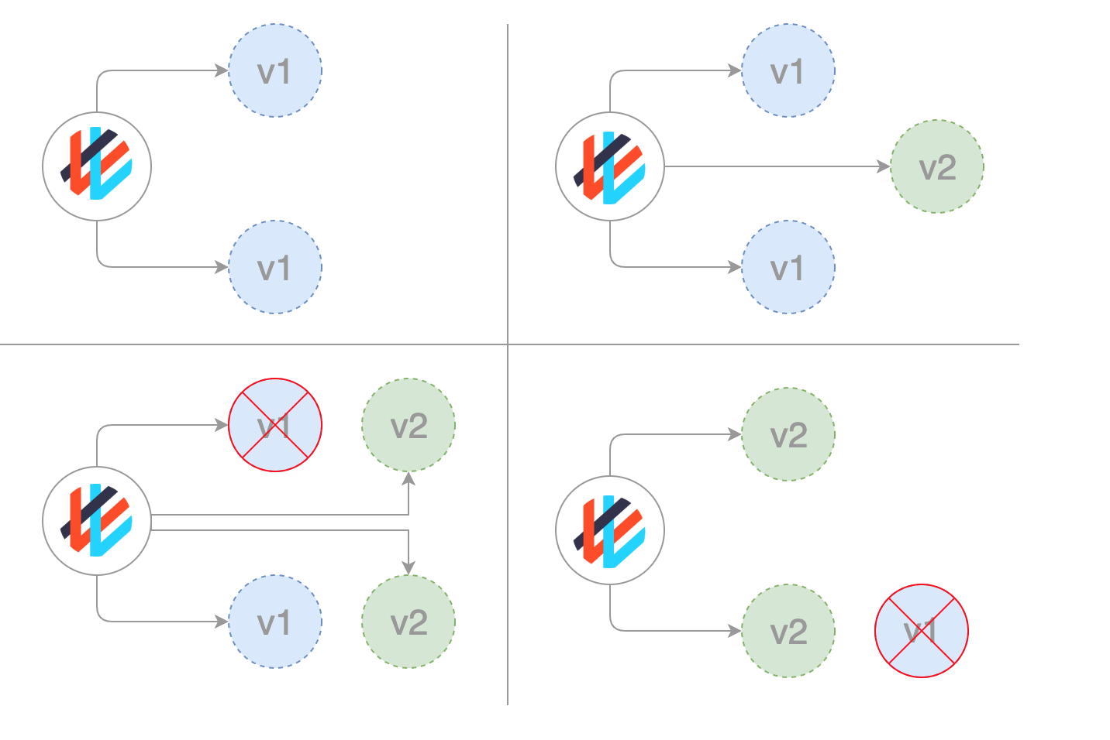
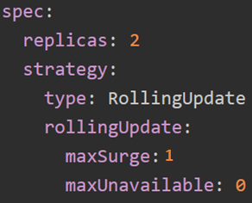
Deployment Strategies - Ramped
maxSurge:- Maximum number of PODs that can be created over the desired number
maxUnavailable: - Maximum number of pods that can be unavailable

Slide 16
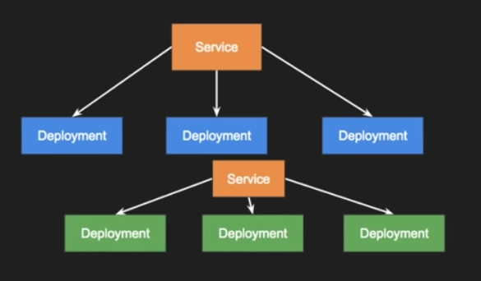
Blue Green deployment

Slide 17
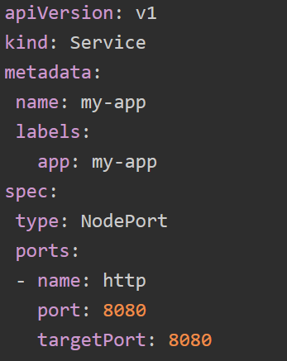
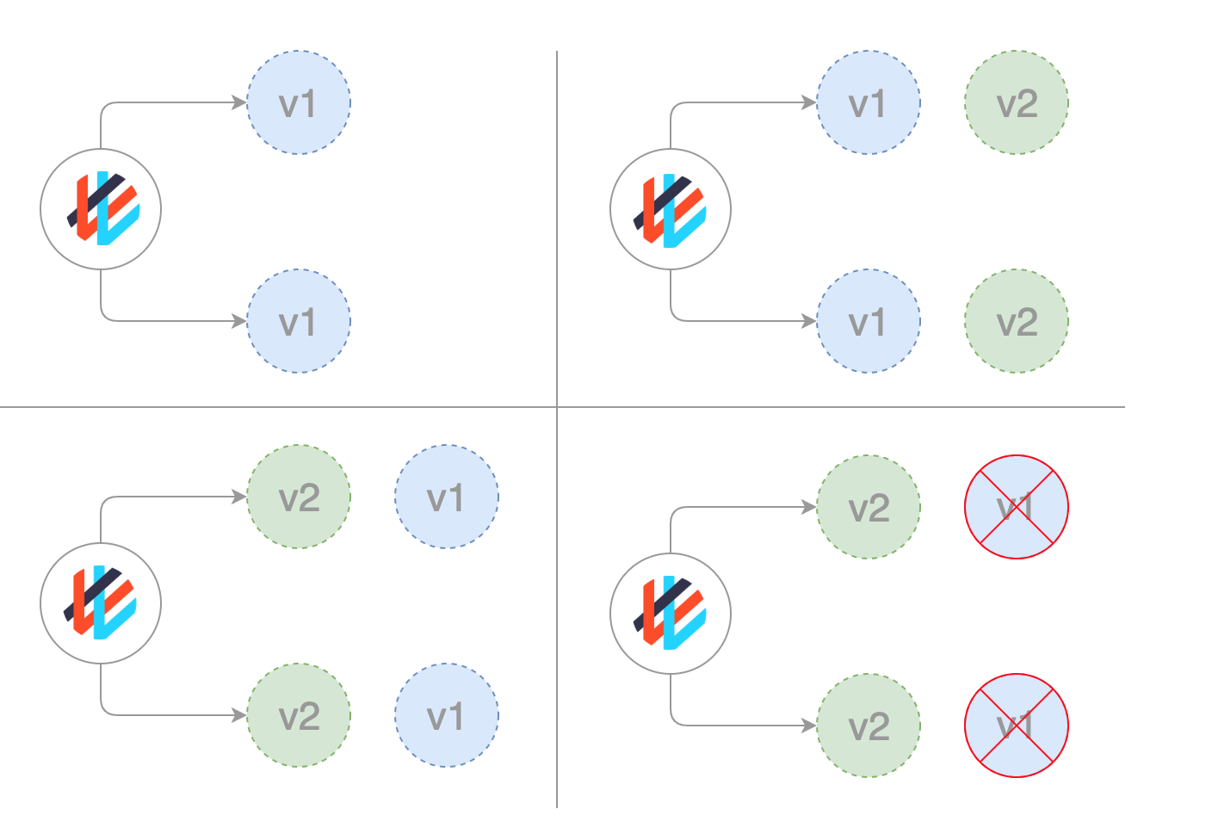
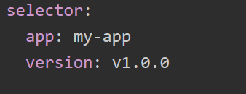

Deployment Strategies – Blue Green

Slide 18
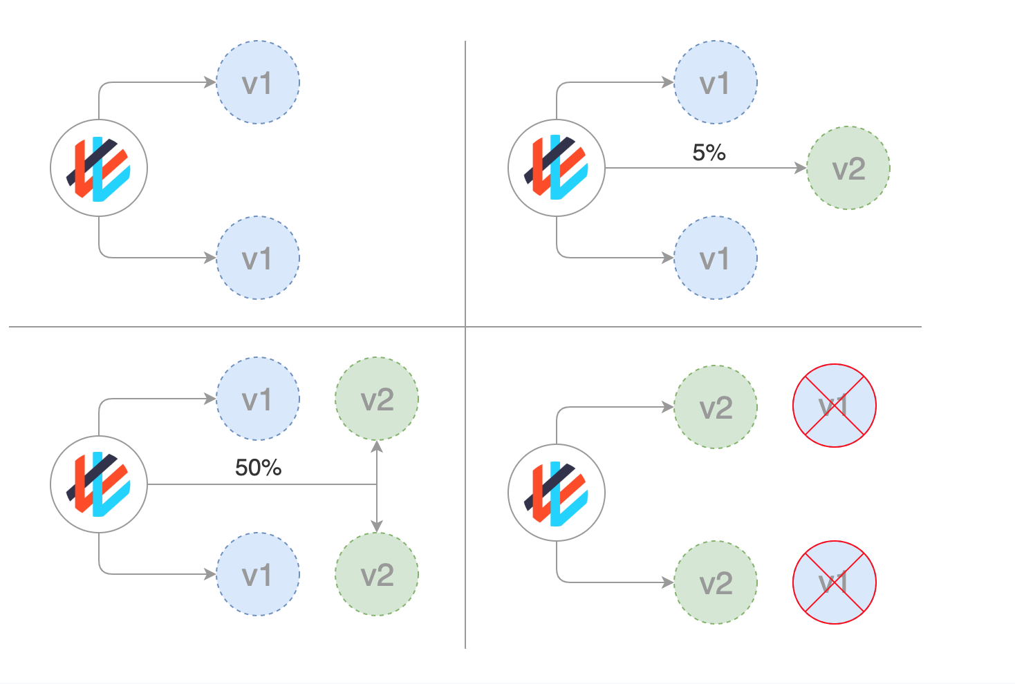

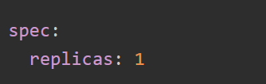
Deployment Strategies – Canary
Progressive delivery

Slide 19
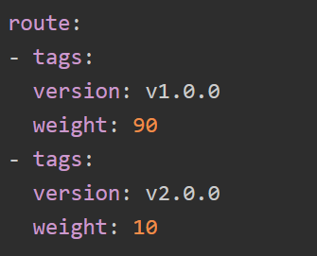
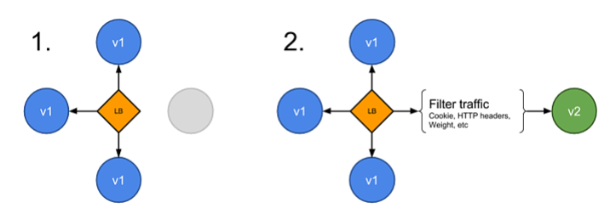
Deployment Strategies – A/B Testing

